Slide 1
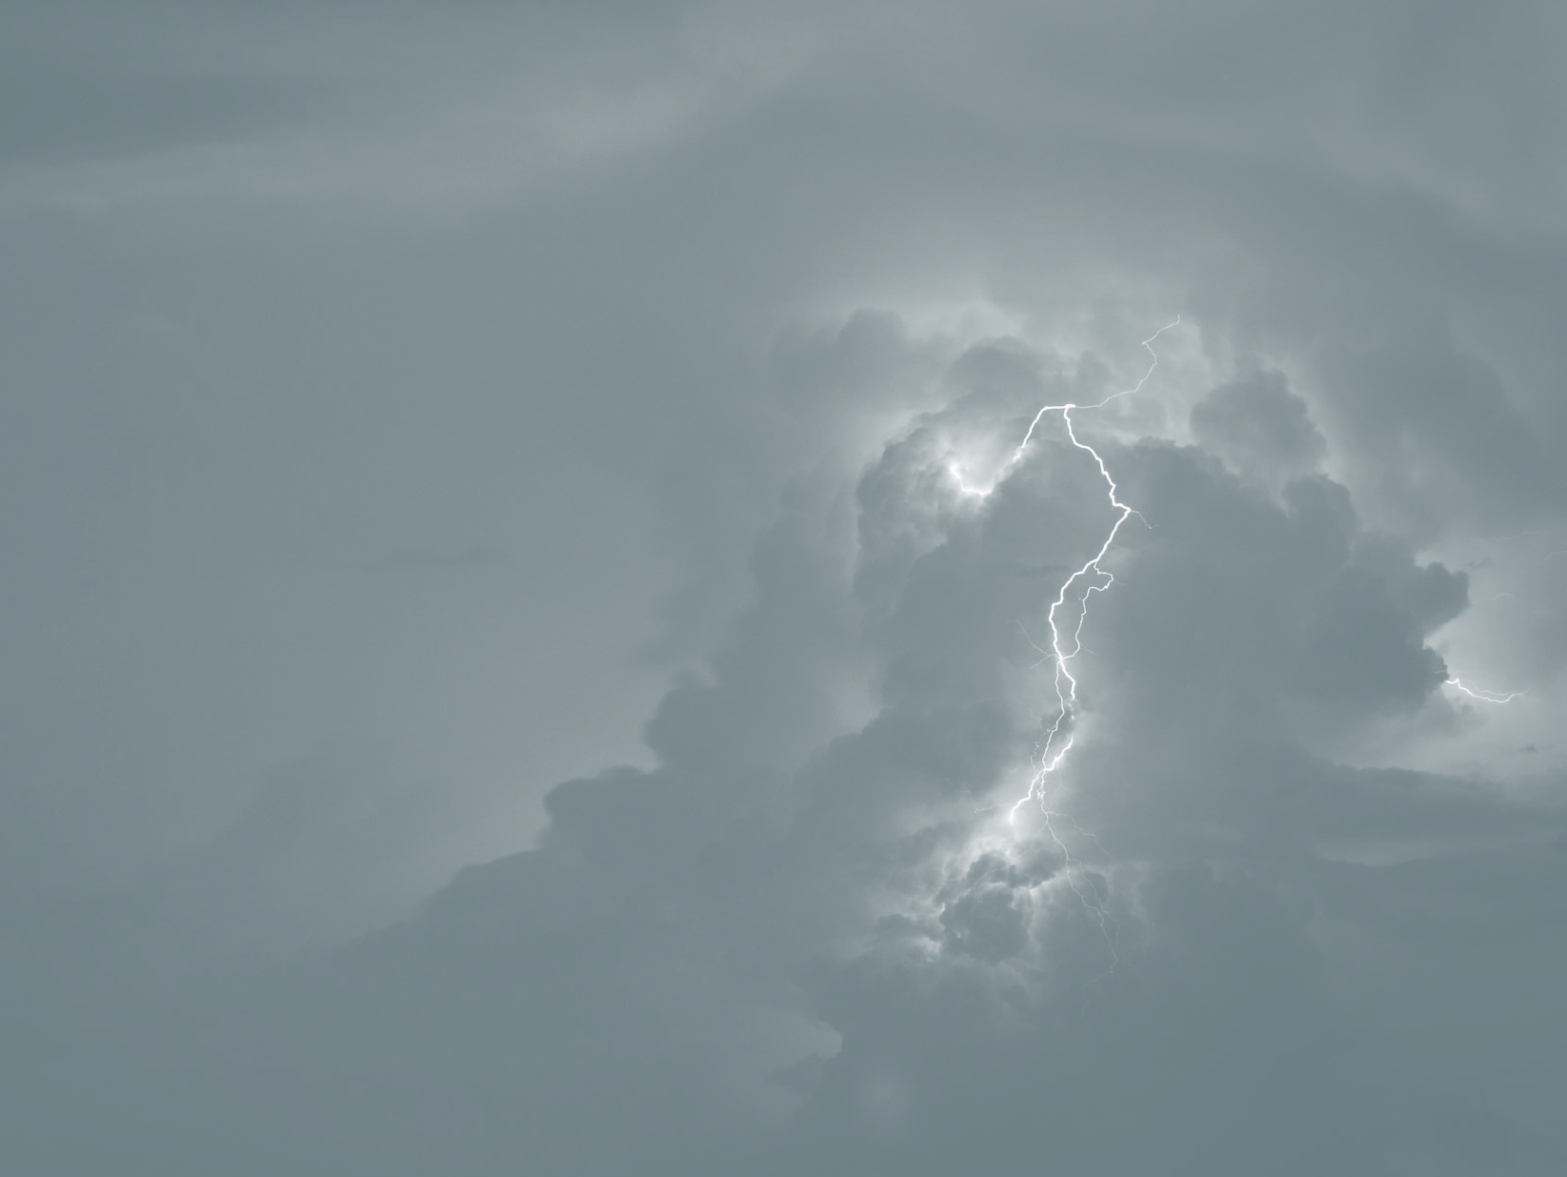
Hillcrest Bible Church
Hymns
November 7-8, 2020

Slide 2
Joyful, Joyful We Adore Thee
Joyful, joyful, we adore Thee,
God of glory, Lord of love;
Hearts unfold like flowers before Thee,
Op’ning to the sun above.
Melt the clouds of sin and sadness;
Drive the dark of doubt away;
Giver of immortal gladness,
Fill us with the light of day!
van Dyke/van Beethoven
Grace 23

Slide 3
Joyful, Joyful We Adore Thee
All Thy works with joy surround Thee,
Earth and heav’n reflect Thy rays,
Stars and angels sing around Thee,
Center of unbroken praise.
Field and forest, vale and mountain,
Flow’ry meadow, flashing sea,
Singing bird and flowing fountain
Call us to rejoice in Thee!
van Dyke/van Beethoven
Grace 23

Slide 4
Joyful, Joyful We Adore Thee
Thou art giving and forgiving,
Ever blessing, ever blest,
Wellspring of the joy of living, Ocean-depth of happy rest!
Thou our Father, Christ our Brother-
All who live in love are Thine;
Teach us how to love each other,
Lift us to the joy divine!
van Dyke/van Beethoven
Grace 23

Slide 5
Joyful, Joyful We Adore Thee
Mortals, join the happy chorus,
Which the morning stars began;
Father love is reigning o’er us,
Draws us through the Son of Man.
Ever singing, march we onward,
Victors in the midst of strife,
Joyful music leads us onward
In the triumph song of life.
van Dyke/Beethoven
Grace 23

Slide 6
Hillcrest Bible Church
Hymns
November 7-8, 2020

Slide 7
This Is My Father’s World
This is my Father’s world,
And to my list’ning ears,
All nature sings, and round me rings
The music of the spheres.
This is my Father’s world: I rest me in the thought
Of rocks and trees, of skies and seas;
His hand the wonders wrought.
Babcock/Sheppard/Barnes
Trinity 109

Slide 8
This Is My Father’s World
This is my Father’s world,
The birds their carols raise,
The morning light, the lily white, Declare their Maker’s praise.
This is my Father’s world: He shines in all that’s fair;
In the rustling grass I hear him pass,
He speaks to me everywhere.
Babcock/Sheppard/Barnes
Trinity 109

Slide 9
This Is My Father’s World
This is my Father’s world,
O let me ne’er forget
That though the wrong seems oft so strong,
God is the Ruler yet.
This is my Father’s world: The battle is not done;
Jesus who died shall be satisfied,
And earth and heav’n be one.
Babcock/Sheppard/Barnes
Trinity 109

Slide 10
Hillcrest Bible Church
Hymns
November 7-8, 2020

Slide 11
My Faith Looks Up to Thee
My faith looks up to thee,
Thou Lamb of Calvary,
Saviour Divine:
Now hear me while I pray,
Take all my guilt away,
O let me from this day
Be wholly thine.
Palmer/Mason
Trinity 454

Slide 12
My Faith Looks Up to Thee
May thy rich grace impart
Strength to my fainting heart,
My zeal inspire;
As thou hast died for me,
O may my love to thee
Pure, warm, and changeless be,
A living fire.
Palmer/Mason
Trinity 454

Slide 13
My Faith Looks Up to Thee
While life’s dark maze I tread,
And griefs around me spread,
Be thou my guide;
Bid darkness turn to day,
Wipe sorrow’s tears away,
Nor let me ever stray
From thee aside.
Palmer/Mason
Trinity 454

Slide 14
My Faith Looks Up to Thee
When ends life’s transient dream,
When death’s cold, sullen stream
Shall o’er me roll,
Blest Saviour, then, in love,
Fear and distrust remove;
O bear me safe above,
A ransomed soul.
Palmer/Mason
Trinity 454

Slide 15
Jude’s Benediction
Now unto Him Who is able
to keep you from falling,
And to make you stand in His presence
blameless and with great joy,
To the only God, our Savior,
through Jesus Christ, our Lord,
Be the glory and the majesty, dominion
and authority, both now and forever, Amen.
Jude 24, 25
Grace 437

